Slide 1
THEORY OF COMPUTATION
Dr.S.Prince Mary M.E.,Ph.D., Associate Professor,
Department of Computer Science and Engineering,
School of Computing
SATHYABAMA
Institute of Science and Technology
Deemed to be University
Chennai.

Slide 2
UNIT- III PUSH DOWN AUTOMATA

Slide 3
Syllabus
Pushdown automata
Introduction
Definition
Deterministic pushdown automata
PDA corresponding to a given context-free grammar
Context-free Grammar corresponding to PDA
Pumping lemma for CFG

Slide 4
Introduction
Pushdown automata is a way to implement a CFG in the same way we design DFA for a regular grammar.
Drawback of FA:
can remember a finite amount of information
No Memory used in FA
Advantages of PDA:
PDA can remember an infinite amount of information.
Memory used – Stack
A PDA is more powerful than FA
Any language which can be acceptable by FA can also be acceptable by PDA.
PDA also accepts a class of language which even cannot be accepted by FA

Slide 5
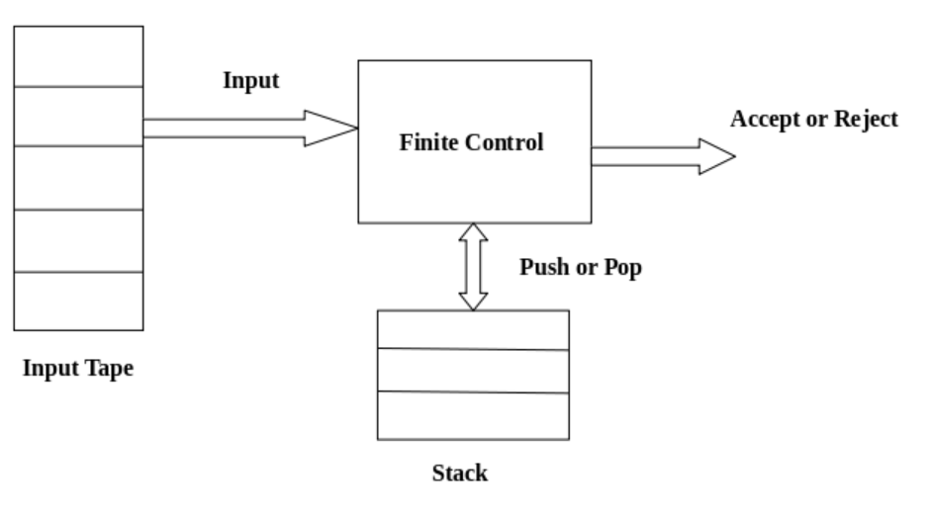
PDA

Slide 6
Formal definition of PDA
The PDA can be defined as a collection of 7 tuples: M=( Q, ∑, Γ, q0, Z, F, δ )
Q: the finite set of states
∑: the input set
Γ: a stack symbol which can be pushed and popped from the stack
q0: the initial state
Z: a start symbol which is in Γ.
F: a set of final states
δ: Transition function which is used for moving from current state to next state.
δ: Q x {Σ ∪ ε} x Γ -> Q x Γ*
Ex: δ(q,a,x)=(p,α)
from state ‘q’ with a input ‘a’, with stack symbol ‘x’, goto state ‘p’, x is replaced by string ‘α’.

Slide 7
Instantaneous Description (ID)
An instantaneous description is a triple ID
(q, w, α)
where:
q describes the current state.
w describes the remaining input.
α describes the stack contents, top at the left.
Example Derivation: (p, b, T) ⊢ (q, w, α)

Slide 8
PDA- Construction
1.Design a PDA for accepting a language {a^{n}b^{n} | n>=1}.
Solution:
In this language, n number of a's should be followed by n number of b’s.
Logic:
If we read single 'a', we will push a onto the stack.
As soon as we read 'b' then for every single 'b' only one 'a' should get popped from the stack.
Define the states:
q0 – push all a’s on to the stack.
q1 – when a ‘b’ encounters, pop ‘a’ from stack.
q2 – accepting state.

Slide 9
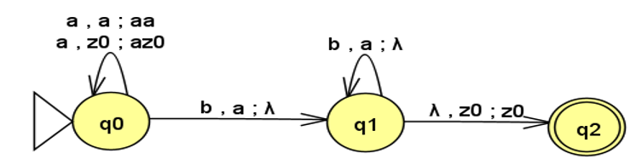
The State Diagram can be constructed as follows:
Push Operation:
δ(q0, a, Z) = (q0, aZ)
δ(q0, a, a) = (q0, aa)
Pop Operation:
δ(q0, b, a) = (q1, ε)
δ(q1, b, a) = (q1, ε)
Accept
δ(q1, ε, Z) = (q2, Z) State Diagram

Slide 10
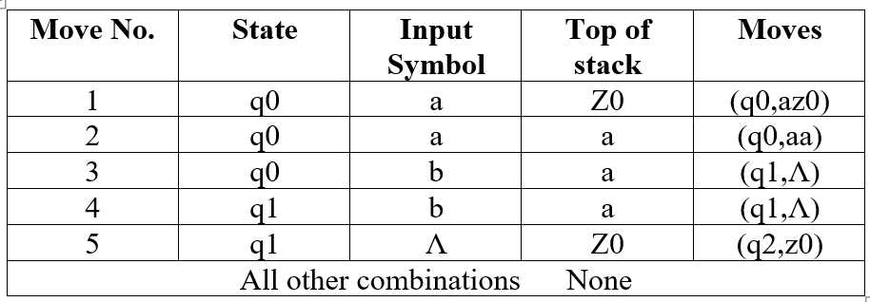
Transition Table

Slide 11
ID
Derive -aaabbb
δ(q0, aaabbb, Z) ⊢ δ(q0, aabbb, aZ)
⊢ δ(q0, abbb, aaZ)
⊢ δ(q0, bbb, aaaZ)
⊢ δ(q1, bb, aaZ)
⊢ δ(q1, b, aZ)
⊢ δ(q1, ε, Z)
⊢ δ(q2, ε)
ACCEPT

Slide 12
Trace the moves: a³b³ aaabbb
Move No. | Resulting state | Input | Stack
- | q0 | aabb | Z0
1 | q0 | abb | aZ
2 | q0 | bb | aaZ
3 | q1 | b | aZ
4 | q1 | ε | Z
5 | q2 | ε | Z

Slide 13
2. Design PDA to accept L={xCx^{r} / x = {a, b}*}
Solution:
Some string will come followed by one 'c', followed by reverse of the string before 'c'.
Logic:
For every a's and b's push them into STACK
When 'c' comes do nothing.
Start popping STACK: 'a' for 'a' and 'b' for 'b'.

Slide 14
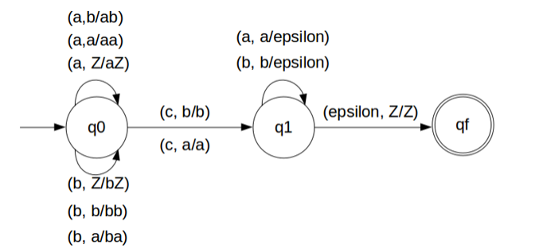
State Diagram:
Transition Fuction:
δ(q0, a, Z) = (q0, aZ)
δ(q0, a, a) = (q0, aa)
δ(q0, b, Z) = (q0, bZ)
δ(q0, b, b) = (q0, bb)
δ(q0, a, b) = (q0, ab)
δ(q0, b, a) = (q0, ba)
// this is decision step
δ(q0, c, a) = (q1, a)
δ(q0, c, b) = (q1, b)
δ(q1, b, b) = (q1, ε)
δ(q1, a, a) = (q1, ε)
δ(q1, ε, Z) = (qf, Z)

Slide 15
ID
Derive : abCba
δ(q0, abCba, Z) ⊢ δ(q0, bCba, aZ)
⊢ δ(q0, Cba, baZ)
⊢ δ(q1, ba, baZ)
⊢ δ(q1, a, aZ)
⊢ δ(q1, ε, Z)
⊢ δ(qf, ε)
Accept

Slide 16
ID
Derive : baCba
δ(q0, baCba, Z) ⊢ δ(q0, aCba, bZ)
⊢ δ(q0, Cba, abZ)
⊢ δ(q1, ba, abZ)
⊢Reject

Slide 17
Trace the moves: abCba
Move No. | Resulting state | Input | Stack
- | q0 | abCba | Z
1 | q0 | bCba | aZ
2 | q0 | Cba | baZ
3 | q1 | ba | baZ
4 | q1 | a | aZ
5 | q1 | Null | Z
6 | q2 | Null | Z (Accepted)

Slide 18
3. Consider the CFG: S->[S] | {S} | ꓥ Generate the CFL and PDA
w={ꓥ,[],{},{[]},{{}},[[]], [{}],…..}
Language: Balanced Parentheses
Solution:
Open parentheses followed by symbol ‘S’ and then closed parentheses.
Define the states:
q0 – push all Open parentheses on to the stack.
q1 – when a close parentheses , pop open parentheses from stack.
q2 – accepting state.

Slide 19
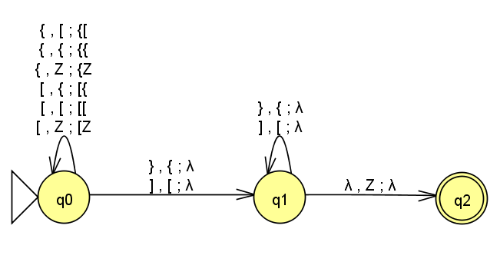
Transition Diagram

Slide 20
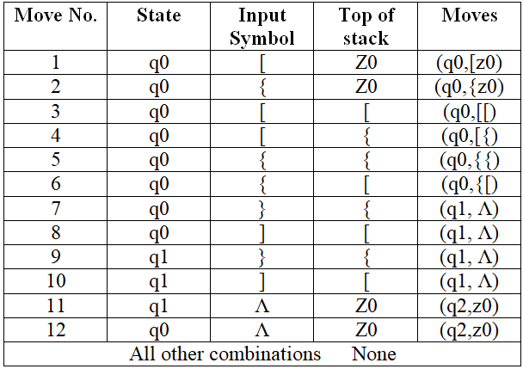
Transition Table

Slide 21
Trace the moves: {[{}]}
Move No. | Resulting state | Input | Stack
- | q0 | {[{}]} | Z0
2 | q0 | [{}]} | {z0
4 | q0 | {}]} | [{z0
6 | q0 | }]} | {[{z0
7 | q1 | ]} | [{z0
10 | q1 | } | {z0
9 | q1 | Ʌ | Z0
11 | q2 | Ʌ | Z0
Accept

Slide 22
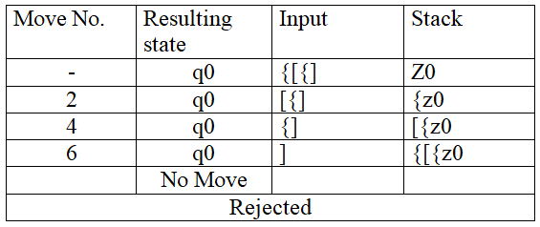
Trace the Moves: {[{]

Slide 23
PDA Acceptance
1. Acceptance by Final State:
Let P =(Q, ∑, Γ, δ, q0, Z, F) be a PDA. The language acceptable by the final state can be defined as:
L(PDA) = {w | (q0, w, Z) ⊢* (p, ε, Z ), p ∈ F}
2. Acceptance by Empty Stack:
Let P =(Q, ∑, Γ, δ, q0, Z, F) be a PDA. The language acceptable by empty stack can be defined as:
N(PDA) = {w | (q0, w, Z) ⊢* (p, ε, ε), p ∈ F}
3. Language Acceptance:
A language L ⊆ ∑* is said to be accepted by M, if L is precisely the set of string accepted by M.
L=L(M)

Slide 24
PDA Corresponding to CFG
Parsing:
To derive a string using the production rules for a grammar.
It is used to check whether or not a string is syntactically correct.
Parser takes the inputs and builds a parse tree.
Two types of parser:
Top down Parser- Parsing starts from the top with the start symbol and derives a string using a parse tree.
Bottom up parser- Starts from the bottom with the string and comes to the start symbol using a parse tree.

Slide 25
Design of Top down parser:
Push the start symbol onto the stack.
If the top of the stack contains a NT, pop it out of the stack and push its right hand side of the production.
If the top of the stack matches with input symbol being read, pop it.
If the input string is fully read and the stack is empty go to final state.

Slide 26
Top Down Parsing
Left Most Derivation is used
Input − CFG, G = (V, T, P, S)
Output − Equivalent PDA, P = (Q, ∑, S, δ, q₀, I, F)
Step 1−The start symbol of CFG is the start symbol in the PDA.
Step 2 − All non-terminals of the CFG will be the stack symbols of the PDA and all the terminals of the CFG will be the input symbols of the PDA.
Step 3 − For each production in the form A → aX make a transition δ (q, a, A).

Slide 27
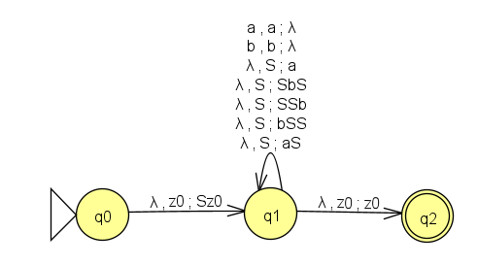
1. Construct PDA corresponding the given Grammar
L={ x ∈ {a,b}* / Na (x) > Nb(x) }
P: S->a/aS/bSS/SSb /SbS
State Diagram:

Slide 28
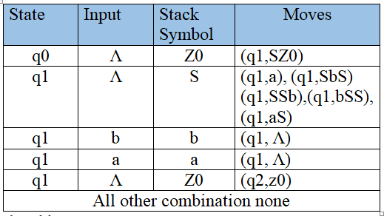
Transition Table:

Slide 29
ID
Derive: abaa
δ(q0, abaa, Z) ⊢ δ(q1, abaa, SZ)
⊢ δ(q1, abaa, SbSZ)
⊢ δ(q1, abaa, abSZ)
⊢ δ(q1, baa, bSZ) LMD
⊢ δ(q1, aa, SZ)
⊢ δ(q1, aa, aSZ)
⊢ δ(q1, a, SZ)
⊢ δ(q1, a, aZ)
⊢ δ(q1, ε, Z)
⊢ q2 (Accept)
S=>SbS =>abS S->a =>abaS S->as =>abaa S->a

Slide 30
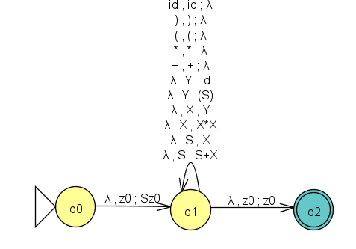
Problem 2:
P: S->S+X | X
X->X*X | Y
Y->(S) | id
String: id+id*id
State Diagram:

Slide 31
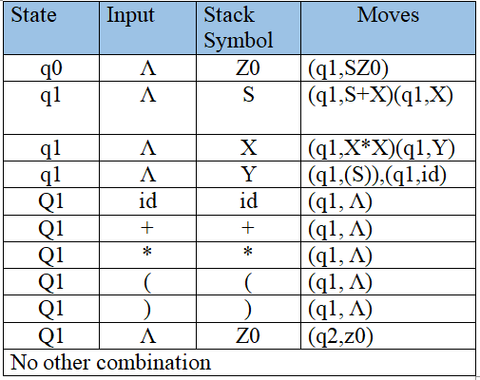
Transition Table:

Slide 32
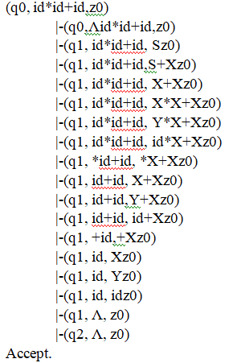
ID
Example: id*id+id
S=>S+X S->S+X
=>X+X S->X
=>X*X+X X->X*X
=>Y*X+X X->Y
=>id*X+X Y->id
=>id*Y+X X->Y
=>id*id+X Y->id
=>id*id+Y X->Y
=>id*id+id Y->id

Slide 33
Bottom Up Parsing
Right Most Derivation in reverse is used.
Steps:
Push the current input symbol into the stack.
Replace the right-hand side of a production at the top of the stack with its left-hand side.
If the top of the stack element matches with the current input symbol, pop it.
If the input string is fully read and only if the start symbol ‘S’ remains in the stack, pop it and go to the final state ‘F’.

Slide 34
Example
P: S->S+T
S->T
T->T*a
T->a
String: a+a*a
Right Most Derivation:
S=>S+T
=>S+T*a [T->T*a]
=>S+a*a [T->a]
=>T+a*a [S->T]
=>a+a*a [T->a]
RMD in Reverse a+a*a [T->a] T+a*a [S->T] S+a*a [T->a] S+T*a [T->T*a] S

Slide 35
Parsing- a+a*a
STACK | INPUT | ACTION
Z | a+a*a | -
Za | +a*a | Shift a
ZT | +a*a | Reduce [T->a]
Z S | +a*a | Reduce [S->T]
Z S+ | a*a | Shift +
Z S+a | *a | Reduce [t->a]
Z S+T | *a | Shift *
Z S+T * | a | Shift a
Z S +T *a | ε | Reduce [ T->T*a]
Z S +T | ε | Reduce [ S-> S+T]
Z S | ε | Accept

Slide 36
Types of PDA
Non- Deterministic PDA
Deterministic PDA

Slide 37
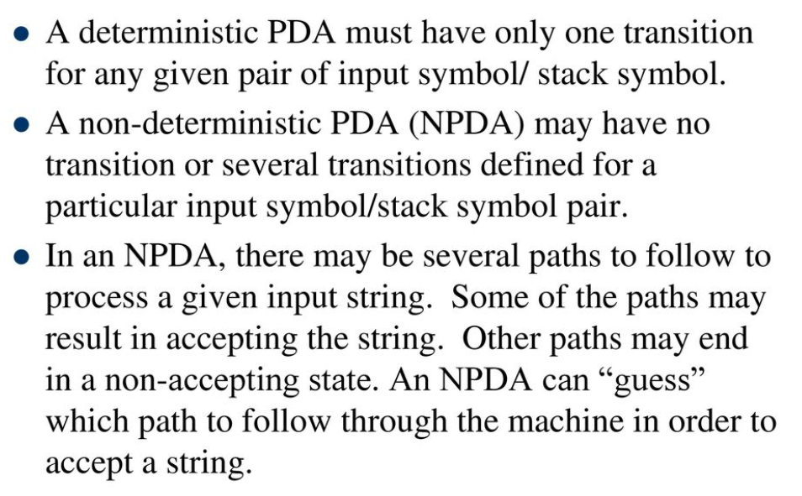
NPDA

Slide 38
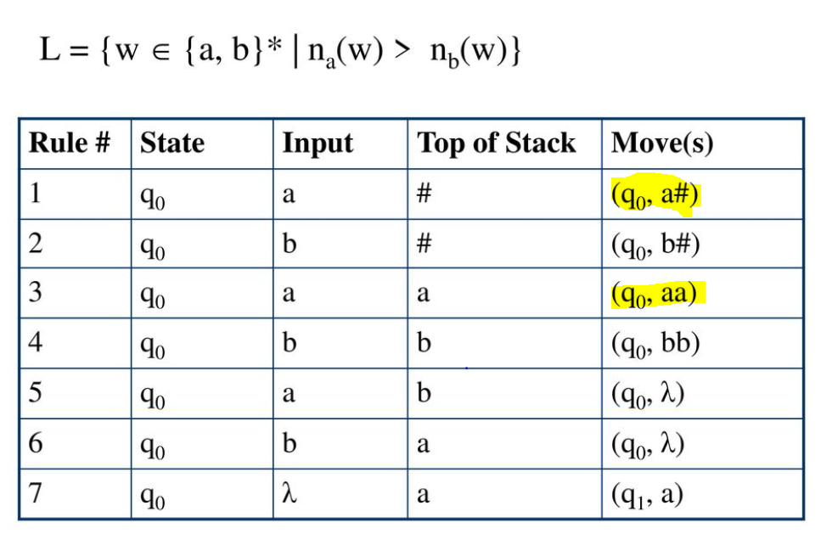
NPDA :L={w ∈ {a,b}* | Na(w)>Nb(w)}

Slide 39
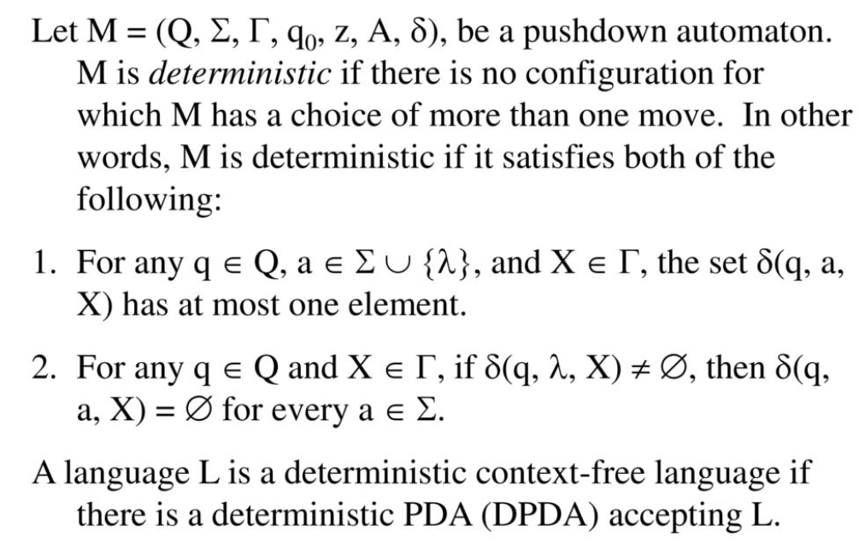
DPDA

Slide 40
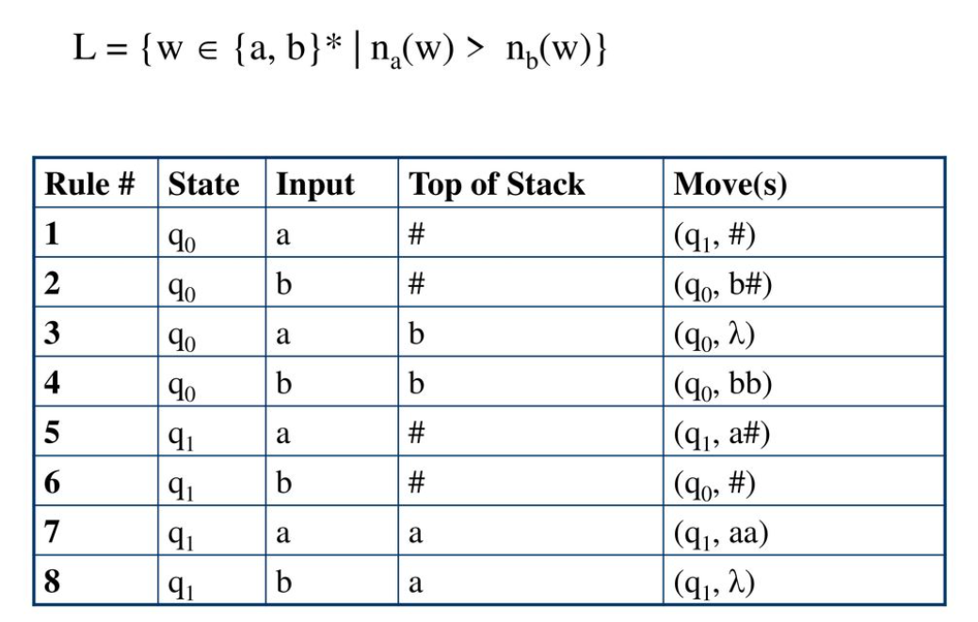
DPDA L={w ∈ {a,b}* | Na(w)>Nb(w)}

Slide 41
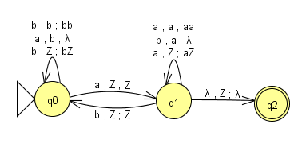
State Diagram

Slide 42
ID
δ(q0, aba, Z) ⊢ δ(q1,ba, Z )
⊢ δ( q0,a,Z )
⊢ δ(q1,null,Z)
q2
accept

Slide 43
PUMPING LEMMA FOR CFL:
Pumping Lemma is used to prove that a language is not CFL.
It should never be used to show a language is regular.
For any language L, we break its strings into five parts and pump second and fourth substring.
Let ‘L’ be any CFL. Then there is a constant ‘n’ depending on L, such that if ‘Z’ is in L and |z|>=n, then we may write,
Z=uvwxy
uv^{i}wx^{i}y ↋ L, For all i>0,
|vx|>=1
|vwx|<=n

Slide 44
Procedure:
Assume that L is context free.
It has to have a pumping length(say n)
Find a string ‘z’ in L such that |z]>=n.
Divide z into uvwxy.
Show that uv^{i}wx^{i}y∉ L

Slide 45
Problem 1:
L={a^{n}b^{n}c^{n}, n>=0} is not a CFL.
Solution:
Assume ‘L’ is a CFL.
Let ‘n’ be a natural number obtained by using pumping lemma.
Let z=a^{n}b^{n}c^{n} |z|=n+n+n=3n
Split z into uvwxy such that |vx|>=1, |vwx|<=n
Assume z=a^{n-i}a^{i}b^{n-j-k}b^{j}b^{k}c^{n}
u=a^{n-i} v=a^{i} w=b^{n-j-k} x=b^{j} y=b^{k}c^{n}
For i=2
=>uv²wx²y =>a^{n-i}a^{i}a^{i}b^{n-j-k}b^{j}b^{j}b^{k}c^{n}
=>a^{n+i}b^{n+j}c^{n}∉L

Slide 46
Eg) n=4
Z=a⁴b⁴c⁴=>aaaabbbbcccc
u=av=aaw=abbbbcx=cy=cc
Let i=2
uv^{i}wx^{i}y =>uv²wx²y=>aaaaaabbbbccccc=>a⁶b⁴c⁵∉L
Therefore the given language is not CFL.

Slide 47
Problem 2:
L={0^{p}|p is prime is not CFL.
Solution:
Assume ‘L’ is a CFL.
Let ‘n’ be a natural number obtained by using pumping lemma.
Let P be a prime no. such that p>=n
Z=0^{p}ϵ L |z|=p>=n
Split z into uvwxy such that |vx|>=1, |vwx|<=n
Let v=0^{k} x=0^{l} such that k+l>=1 and <=n
Hence |uwy|=p-k-l
If we pump v and x p+1 times
|uvwxy|=|uwy|+|v^{(p+1)}.x^{(p+1)}|
=p-k-l+k(p+1)+l(p+1)
=p-k-l+pk+k+pl+l
=p+pk+pl
=p(k+l+1)
Which is not prime.

